Slide 1
Clustering II

Slide 2


Hierarchical Clustering
Produces a set of nested clusters organized as a hierarchical tree
Can be visualized as a dendrogram
  A tree-like diagram that records the sequences of merges or splits

Slide 3
Strengths of Hierarchical Clustering
No assumptions on the number of clusters
  Any desired number of clusters can be obtained by ‘cutting’ the dendogram at the proper level
Hierarchical clusterings may correspond to meaningful taxonomies
  Example in biological sciences (e.g., phylogeny reconstruction, etc), web (e.g., product catalogs) etc

Slide 4
Hierarchical Clustering
Two main types of hierarchical clustering
  Agglomerative:
    Start with the points as individual clusters
    At each step, merge the closest pair of clusters until only one cluster (or k clusters) left
  Divisive:
    Start with one, all-inclusive cluster
    At each step, split a cluster until each cluster contains a point (or there are k clusters)
Traditional hierarchical algorithms use a similarity or distance matrix
  Merge or split one cluster at a time

Slide 5
Complexity of hierarchical clustering
Distance matrix is used for deciding which clusters to merge/split
At least quadratic in the number of data points
Not usable for large datasets

Slide 6
Agglomerative clustering algorithm
Most popular hierarchical clustering technique
Basic algorithm
  Compute the distance matrix between the input data points
  Let each data point be a cluster
  Repeat
  Merge the two closest clusters
  Update the distance matrix
  Until only a single cluster remains
Key operation is the computation of the distance between two clusters
  Different definitions of the distance between clusters lead to different algorithms

Slide 7
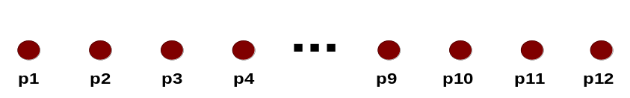
Input/ Initial setting
Start with clusters of individual points and a distance/proximity matrix
p1
p2
p3
p4
p5
. . .
p1
p2
p3
p4
p5
.
.
.
Distance/Proximity Matrix

Slide 8
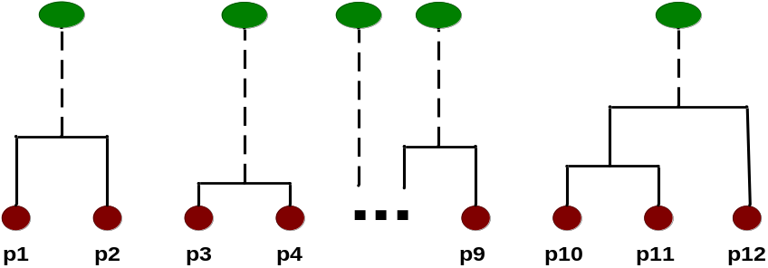
Intermediate State
After some merging steps, we have some clusters
C1
C2
C3
C4
C5
C1
C2
C3
C3
C4
C4
C5
C1
Distance/Proximity Matrix
C2
C5

Slide 9

Intermediate State
Merge the two closest clusters (C2 and C5) and update the distance matrix.
C1
C2
C3
C4
C5
C1
C3
C2
C4
C3
C4
C5
C1
Distance/Proximity Matrix
C2
C5

Slide 10

After Merging
“How do we update the distance matrix?”
C2 U C5
C1
C3
C4
C3
C1
?
C4
C2 U C5
? ? ? ?
C3
?
C1
C4
?
C2 U C5

Slide 11
Distance between two clusters
Each cluster is a set of points
How do we define distance between two sets of points
  Lots of alternatives
  Not an easy task

Slide 12
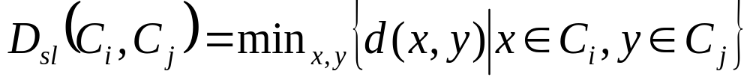
Distance between two clusters
Single-link distance between clusters C_{i} and C_{j} is the minimum distance between any object in C_{i} and any object in C_{j}
The distance is defined by the two most similar objects

Slide 13

Single-link clustering: example
Determined by one pair of points, i.e., by one link in the proximity graph.
1
2
3
4
5

Slide 14

Single-link clustering: example
5
1
3
5
2
1
2
3
6
4
4
Nested Clusters
Dendrogram

Slide 15
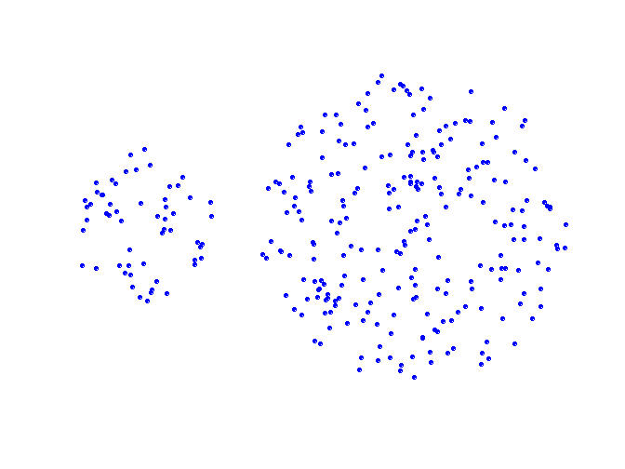
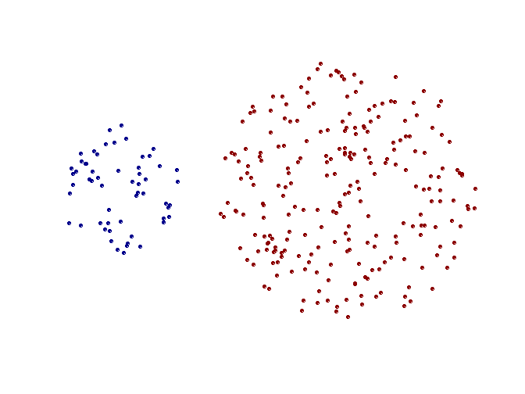
Strengths of single-link clustering
Original Points
Two Clusters
Can handle non-elliptical shapes

Slide 16
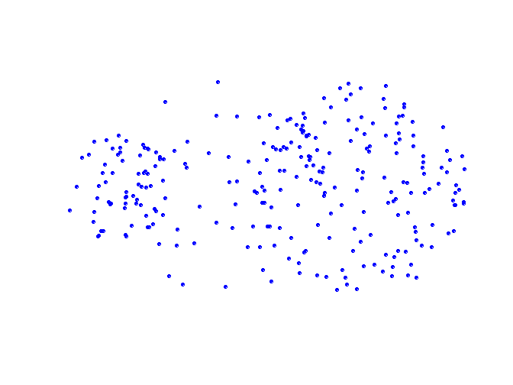
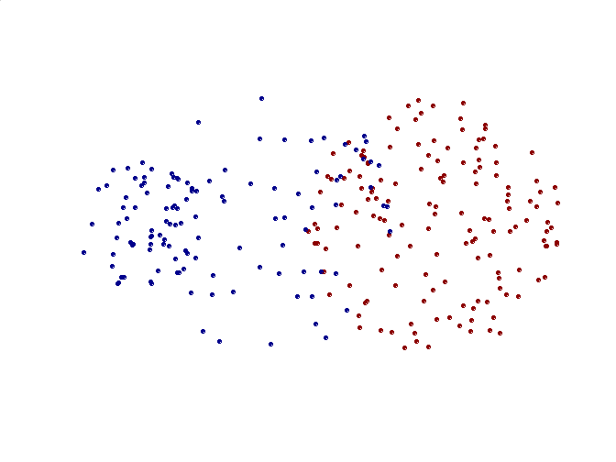
Limitations of single-link clustering
Original Points
Two Clusters
Sensitive to noise and outliers
It produces long, elongated clusters

Slide 17
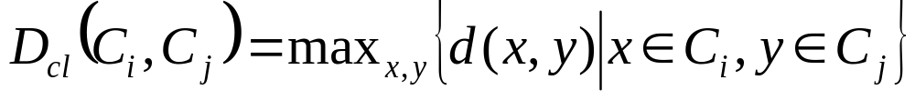
Distance between two clusters
Complete-link distance between clusters C_{i} and C_{j} is the maximum distance between any object in C_{i} and any object in C_{j}
The distance is defined by the two most dissimilar objects

Slide 18

Complete-link clustering: example
Distance between clusters is determined by the two most distant points in the different clusters
1
2
3
4
5

Slide 19
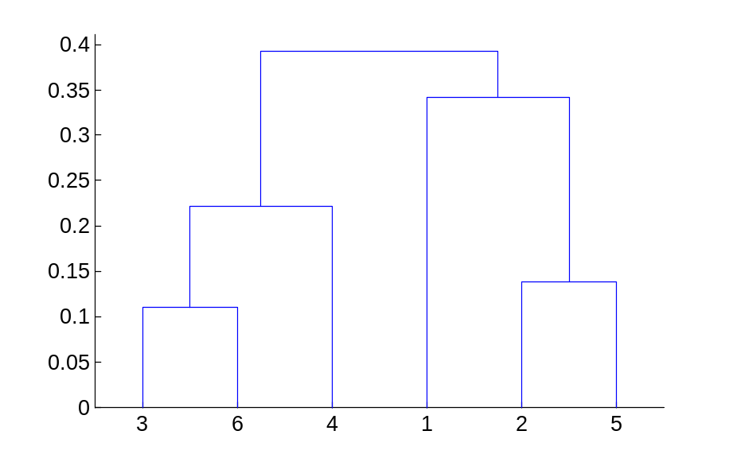
Complete-link clustering: example
4
1
2
5
5
2
3
6
3
1
4
Nested Clusters
Dendrogram

Slide 20
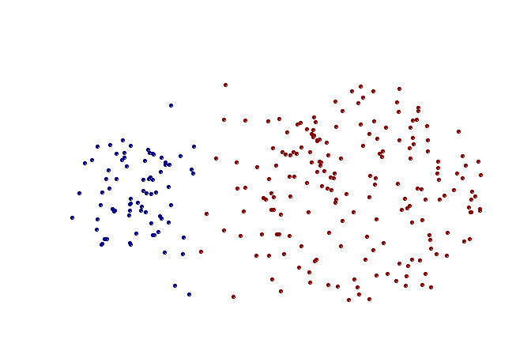
Strengths of complete-link clustering
Original Points
Two Clusters
More balanced clusters (with equal diameter)
Less susceptible to noise

Slide 21
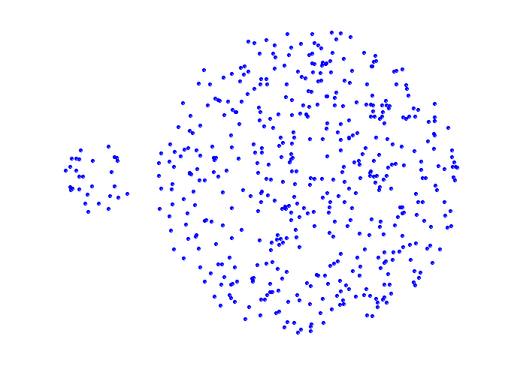
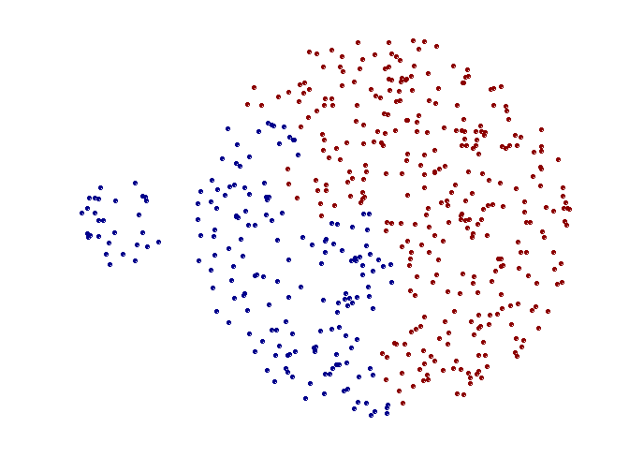
Limitations of complete-link clustering
Original Points
Two Clusters
Tends to break large clusters
All clusters tend to have the same diameter – small clusters are merged with larger ones

Slide 22
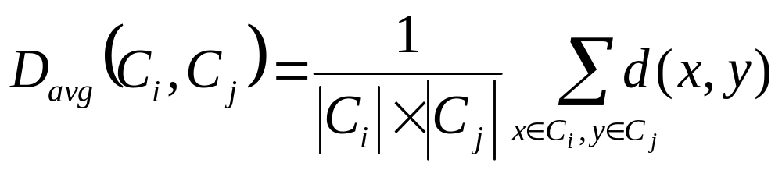
Distance between two clusters
Group average distance between clusters C_{i} and C_{j} is the average distance between any object in C_{i} and any object in C_{j}

Slide 23

Average-link clustering: example
Proximity of two clusters is the average of pairwise proximity between points in the two clusters.
1
2
3
4
5

Slide 24

Average-link clustering: example
5
4
1
2
5
2
3
6
1
4
3
Nested Clusters
Dendrogram

Slide 25
Average-link clustering: discussion
Compromise between Single and Complete Link
Strengths
  Less susceptible to noise and outliers
Limitations
  Biased towards globular clusters

Slide 26
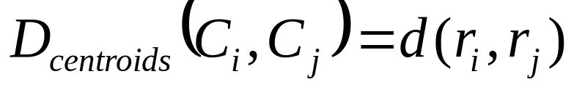
Distance between two clusters
Centroid distance between clusters C_{i} and C_{j} is the distance between the centroid r_{i} of C_{i} and the centroid r_{j} of C_{j}

Slide 27
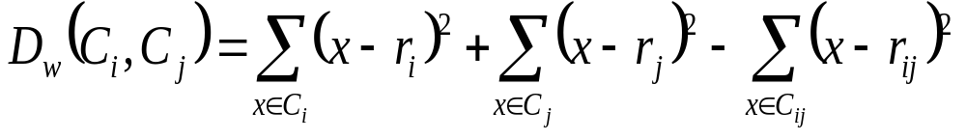
Distance between two clusters
Ward’s distance between clusters C_{i} and C_{j} is the difference between the total within cluster sum of squares for the two clusters separately, and the within cluster sum of squares resulting from merging the two clusters in cluster C_{ij}
r_{i}: centroid of C_{i}
r_{j}: centroid of C_{j}
r_{ij}: centroid of C_{ij}

Slide 28
Ward’s distance for clusters
Similar to group average and centroid distance
Less susceptible to noise and outliers
Biased towards globular clusters
Hierarchical analogue of k-means
  Can be used to initialize k-means

Slide 29
Hierarchical Clustering: Comparison
5
1
4
1
3
2
5
5
5
2
1
MIN
2
MAX
2
3
6
3
3
6
1
4
4
4
5
5
1
4
1
2
2
5
2
Ward’s Method
5
2
3
6
Group Average
3
3
6
4
1
1
4
4
3

Slide 30
Hierarchical Clustering: Time and Space requirements
For a dataset X consisting of n points
O(n²) space; it requires storing the distance matrix
O(n³) time in most of the cases
  There are n steps and at each step the size n² distance matrix must be updated and searched
  Complexity can be reduced to O(n² log(n) ) time for some approaches by using appropriate data structures

Slide 31
Divisive hierarchical clustering
Start with a single cluster composed of all data points
Split this into components
Continue recursively
Monothetic divisive methods split clusters using one variable/dimension at a time
Polythetic divisive methods make splits on the basis of all variables together
Any intercluster distance measure can be used
Computationally intensive, less widely used than agglomerative methods

Slide 32
Model-based clustering
Assume data generated from k probability distributions
Goal: find the distribution parameters
Algorithm: Expectation Maximization (EM)
Output: Distribution parameters and a soft assignment of points to clusters

Slide 33
Model-based clustering
Assume k probability distributions with parameters: (θ₁,…, θ_{k})
Given data X, compute (θ₁,…, θ_{k}) such that Pr(X|θ₁,…, θ_{k}) [likelihood] or ln(Pr(X|θ₁,…, θ_{k})) [loglikelihood] is maximized.
Every point xєX need not be generated by a single distribution but it can be generated by multiple distributions with some probability [soft clustering]

Slide 34
EM Algorithm
Initialize k distribution parameters (θ₁,…, θ_{k}); Each distribution parameter corresponds to a cluster center
Iterate between two steps
  Expectation step: (probabilistically) assign points to clusters
  Maximation step: estimate model parameters that maximize the likelihood for the given assignment of points

Slide 35
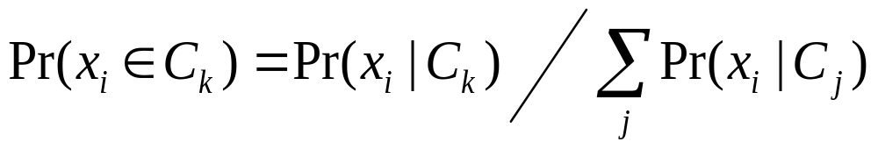
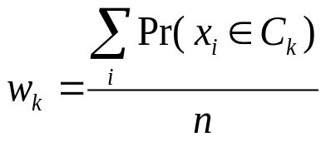
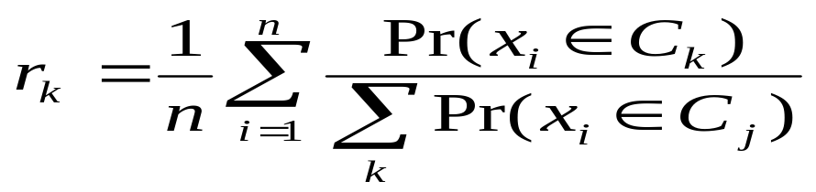
EM Algorithm
Initialize k cluster centers
Iterate between two steps
  Expectation step: assign points to clusters
  Maximation step: estimate model parameters

